Slide 1
Programming Languages -1
(Introduction to C) files
Instructor: M.Fatih AMASYALI
E-mail:mfatih@ce.yildiz.edu.tr

Slide 2
Streams
I/O done through streams; two kinds: text and binary
  Text streams are sequences of lines, each of which is a sequence of characters terminated by a newline
  Binary streams are sequences of characters corresponding to internal representation of data.
Streams created by opening files and referenced using stream pointers (FILE *)
Normally three standard streams are automatically open:
  stdin (stream for standard input - from keyboard)
  stdout (stream for standard output - to screen)
  stderr (stream for standard error output - to screen)

Slide 3
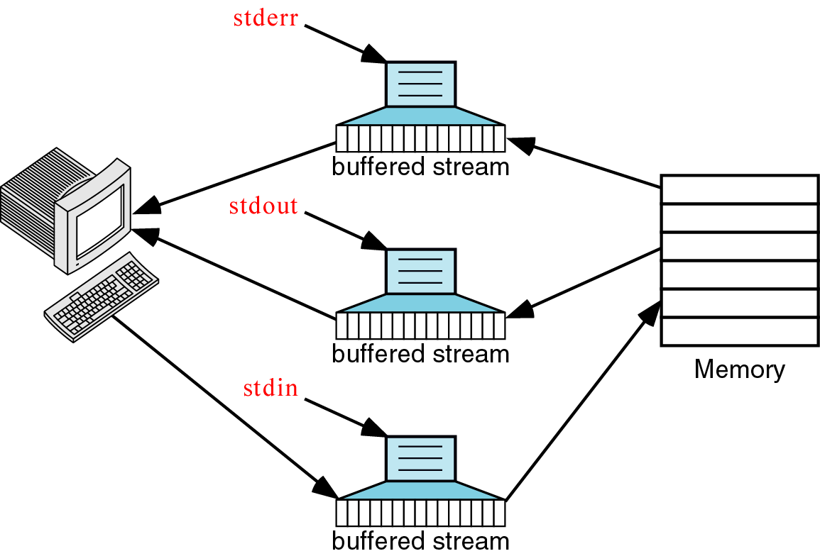
Standard files
There are three standard file variables in C - stdin, stdout and stderr
stdin is linked to the primary input device – usually the keyboard.
stdout and stderr are linked to the primary output device – usually the monitor

Slide 4
Data files
  Can be created, updated, and processed by C programs
  Are used for permanent storage of large amounts of data
    Storage of data in variables and arrays is only temporary

Slide 5
Data Hierarchy
Data Hierarchy:
  Bit – smallest data item
    Value of 0 or 1
  Byte – 8 bits
    Used to store a character
      Decimal digits, letters, and special symbols
  Field – group of characters conveying meaning
    Example: your name
  Record – group of related fields
    Represented by a struct or a class
    Example: In a payroll system, a record for a particular employee that contained his/her identification number, name, address, etc.

Slide 6
Data Hierarchy
Data Hierarchy (continued):
  File – group of related records
    Example: payroll file
  Database – group of related files

Slide 7
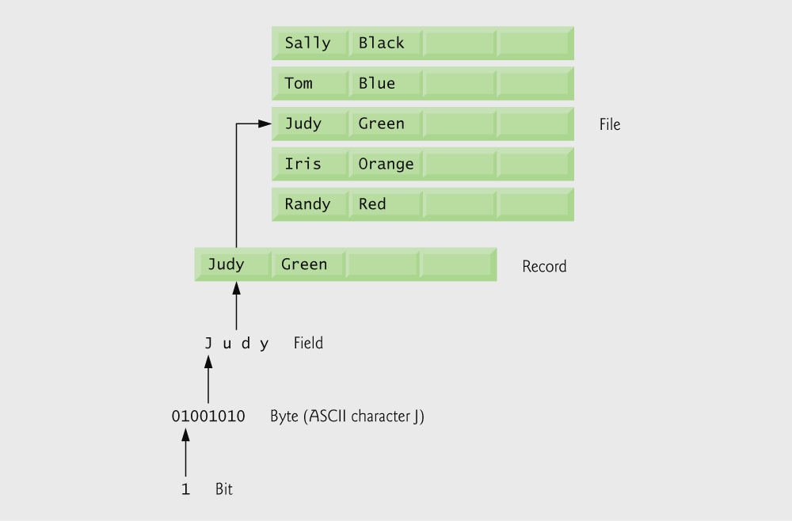
Data hierarchy.

Slide 8
Files and Streams
Read/Write functions in standard library
  fgetc
    Reads one character from a file
    Takes a FILE pointer as an argument
    fgetc( stdin ) equivalent to getchar()
  fputc
    Writes one character to a file
    Takes a FILE pointer and a character to write as an argument
    fputc( 'a', stdout ) equivalent to putchar( 'a' )
  fgets
    Reads a line from a file
  fputs
    Writes a line to a file
  fscanf / fprintf
    File processing equivalents of scanf and printf

Slide 9
Creating a Sequential-Access File
C imposes no file structure
  No notion of records in a file
  Programmer must provide file structure
Creating a File
  FILE *cfPtr;
    Creates a FILE pointer called cfPtr
  cfPtr = fopen(“clients.dat", “w”);
    Function fopen returns a FILE pointer to file specified
    Takes two arguments – file to open and file open mode
    If open fails, NULL returned

Slide 10
Creating a Sequential-Access File
  fprintf
    Used to print to a file
    Like printf, except first argument is a FILE pointer (pointer to the file you want to print in)
  feof( FILE pointer )
    Returns true if end-of-file indicator (no more data to process) is set for the specified file
  fclose( FILE pointer )
    Closes specified file
    Performed automatically when program ends
    Good practice to close files explicitly
Details
  Programs may process no files, one file, or many files
  Each file must have a unique name and should have its own pointer

Slide 11
Notes on Filenames
Unless a directory path is specified, the program will look for the file in the current directory.
Directory paths in filenames: DOS/Windows
sysFile = fopen(“C:\\win\\system.ini”, “r”);
Directory paths in filenames: Unix
passFile = fopen(“/usr/etc/passwd”, “r”);

Slide 12
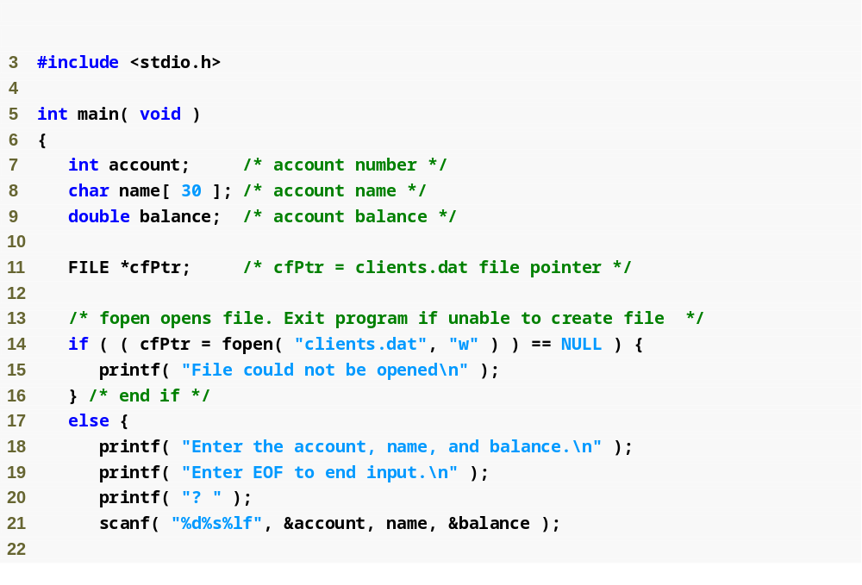
FILE pointer definition creates new file pointer
fopen function opens a file; w argument means the file is opened for writing

Slide 13
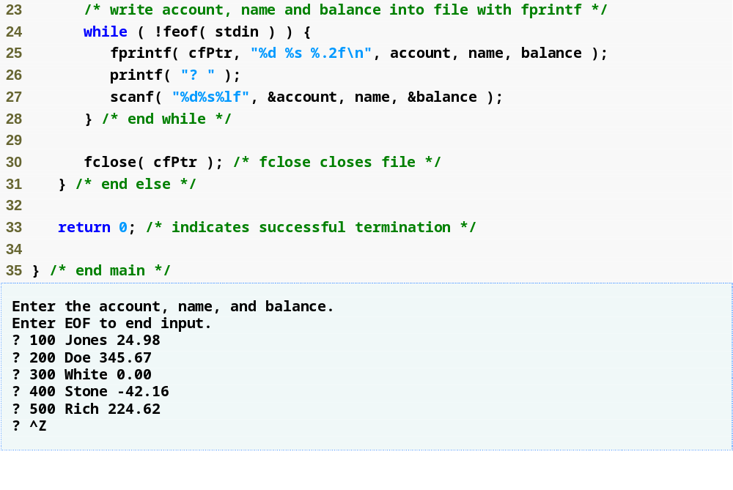
feof returns true when end of file is reached
fprintf writes a string to a file
fclose closes a file

Slide 14
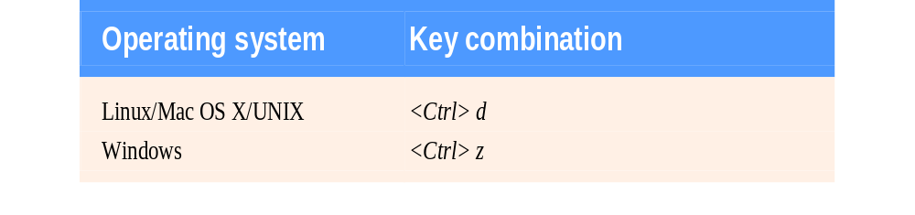
End-of-file key combinations for various popular
operating systems.

Slide 15
Good Programming Practice
Explicitly close each file as soon as it is known that the program will not reference the file again.
Closing a file can free resources for which other users or programs may be waiting.

Slide 16
Error-Prevention Tip
Open a file only for reading (and not update) if the contents of the file should not be modified. This prevents unintentional modification of the file’s contents. This is another example of the principle of least privilege.

Slide 17
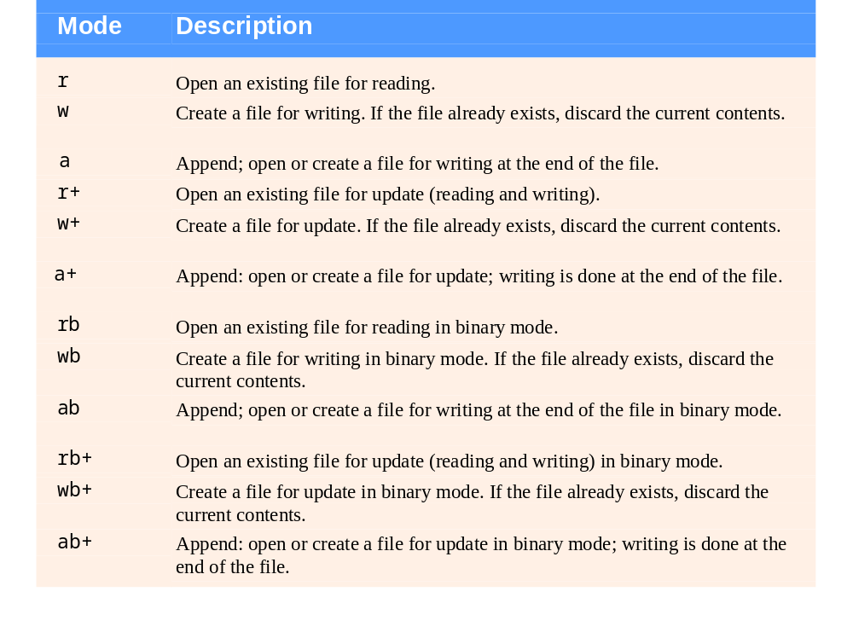
File opening modes.

Slide 18
Reading Data from a Sequential-Access File
Reading a sequential access file
  Create a FILE pointer, link it to the file to read
    cfPtr = fopen( “clients.dat", "r" );
  Use fscanf to read from the file
    Like scanf, except first argument is a FILE pointer
    fscanf( cfPtr, "%d%s%f", &accounnt, name, &balance );
  Data read from beginning to end
  File position pointer
    Indicates number of next byte to be read / written
    Not really a pointer, but an integer value (specifies byte location)
    Also called byte offset
  rewind( cfPtr )
    Repositions file position pointer to beginning of file (offset=0)

Slide 19
Reading all numbers from a file and
then prints their average onto the screen
#include<stdio.h>
int main(void)
{ FILE *fpTemps;
int number;
int count;
int sum;
float avrg;
sum=0;
count=0;
fpTemps = fopen("TEMPS.DAT", "r");
while ( feof(fpTemps)!= 0 )
{
fscanf(fpTemps,"%d",&number);
sum += number;
count++;
}
fclose(fpTemps);
avrg = (float)sum/(float)count;
printf("%.2f", avrg);
return 0;
}

Slide 20
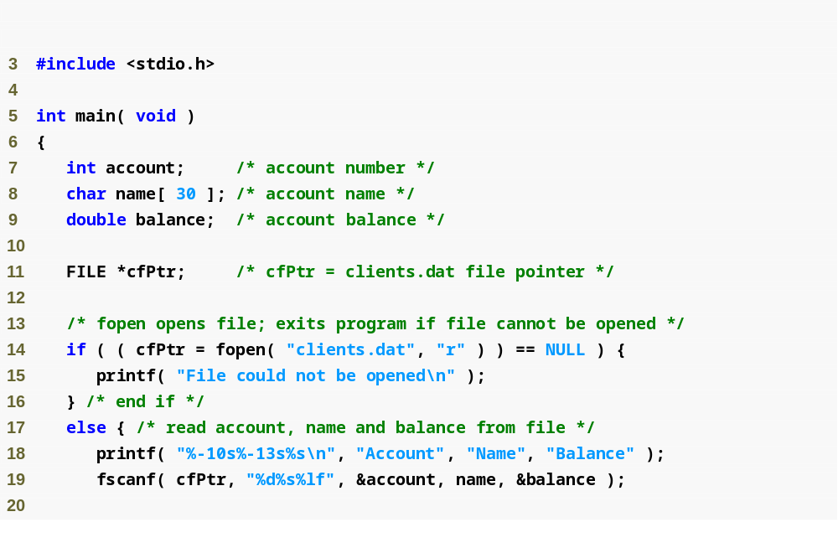
fopen function opens a file; r argument means the file is opened for reading

Slide 21
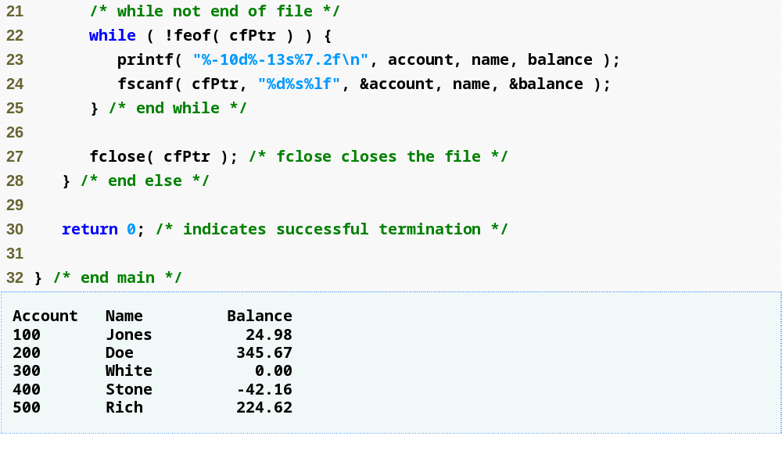
fscanf function reads a string from a file

Slide 22
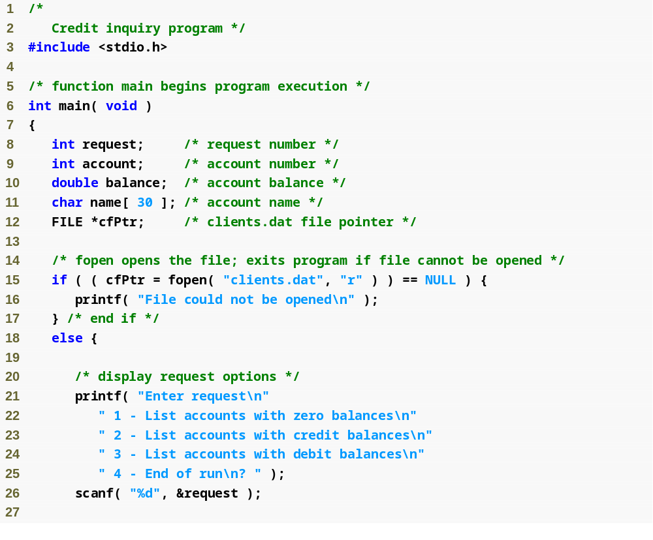

Slide 23
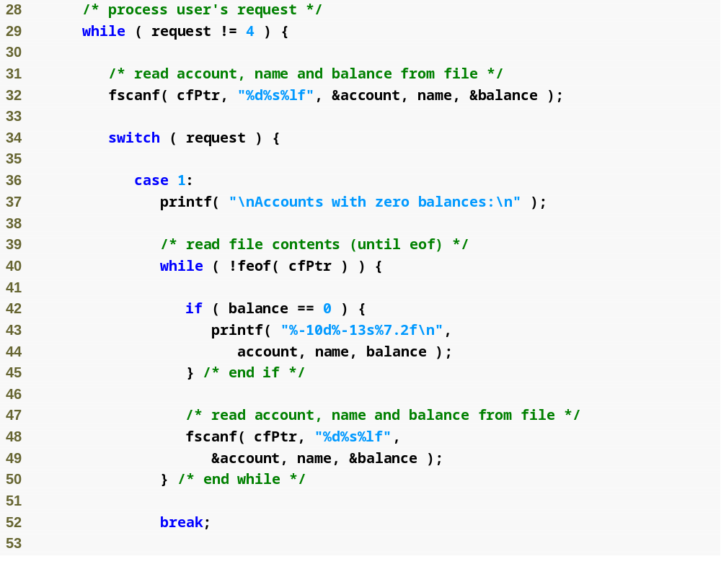

Slide 24
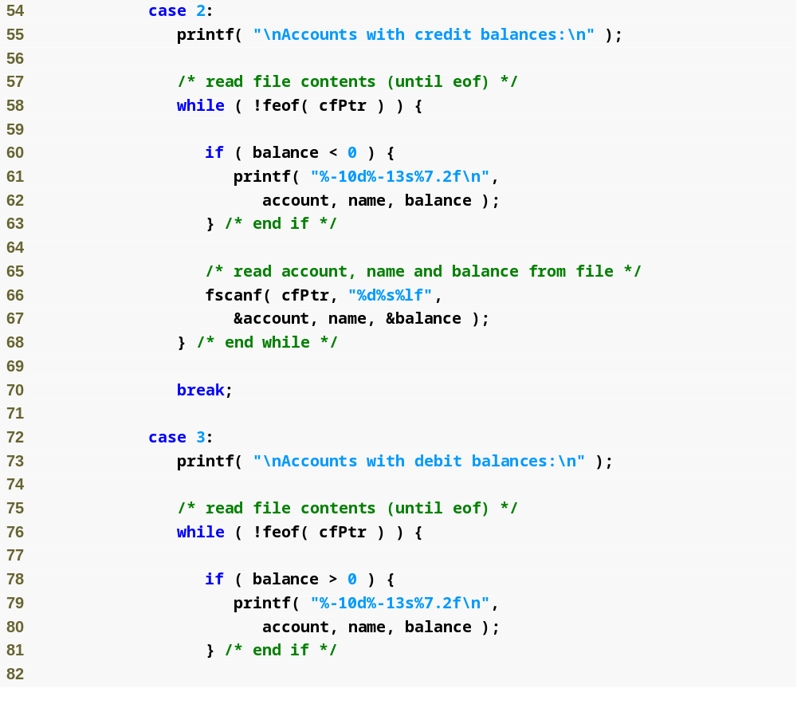

Slide 25
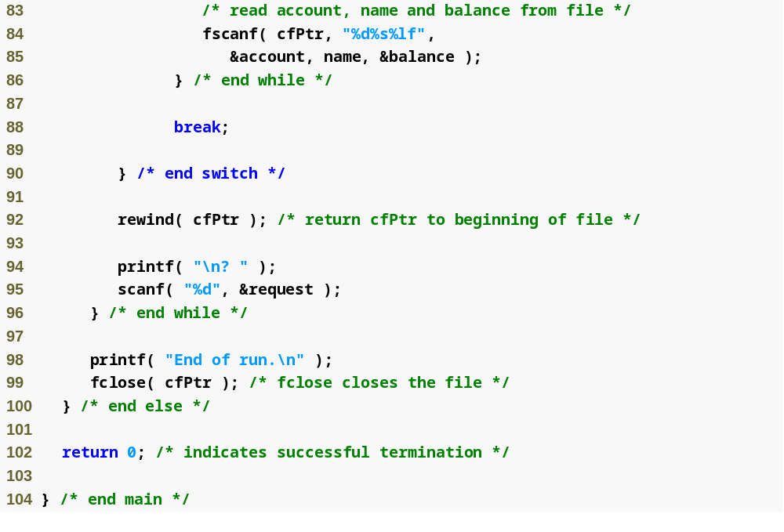
rewind function moves the file pointer back to the beginning of the file

Slide 26
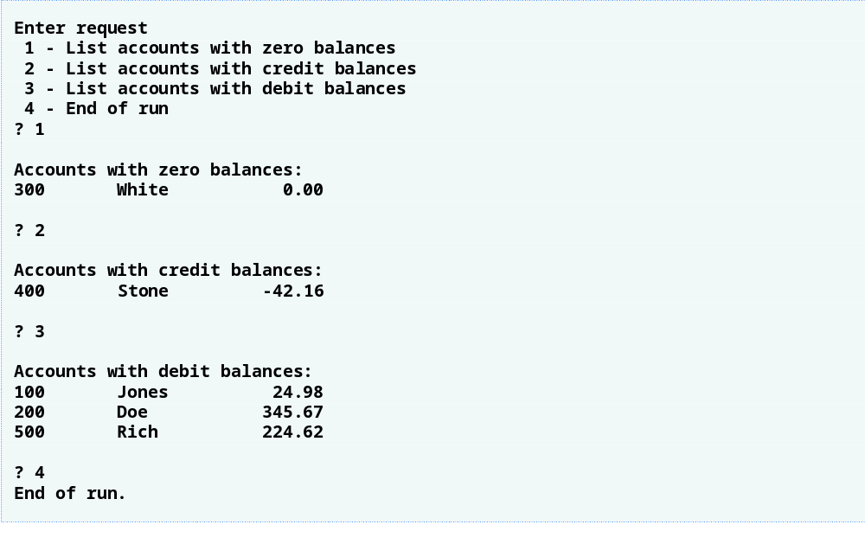
Output

Slide 27
Notes on
Strings and fscanf()
Reading in a string:
  fscanf(stream, “%s”, string)
  Reads only a "word" at a time.
  Words are separated by a white-space: (space, tab, newline, or any combination of these)
  Moves to the next word in the stream automatically after each read.
scanf(“%s”, string)
  behaves similarly, except input stream is stdin.
  eg:== fscanf(stdin, “%s”, string)

Slide 28
Checking for EOF
Both scanf() and fscanf() return:
  the number of input items converted and assigned successfully
  or the constant value EOF when an error or end-of-file occurs,

Slide 29
Checking for EOF
To check for end-of-file (or any other input error), check that the number of items converted and assigned successfully is equal to the expected number of items.
while ( fscanf(inpf, "%s %f", name, &mark) == 2 )
{
printf("%s\t %f\n", name, mark);
}

Slide 30
Example: Count Words
Write a program which counts the number of "words" in a file.
  Note that as far as scanf() and fscanf() are concerned, any sequence of non-whitespace characters is a "word."

Slide 31

Count Words: Algorithm
ask the user for the name of the file
open the file
check if file is opened successfully
count the number of words in the file
print out the count
close the file
Duh?

Slide 32

Count Words: Algorithm
set count to 0
loop
{
read a word from the file
if attempt to read a word failed
then { exit loop }
add 1 to count
}
Gotta write a function for this!

Slide 33
Function: countWords()
Function prototype:
  int countWords ( FILE *inpf );
Description:
  This function returns the number of "words" in the input stream inpf.

Slide 34
Function: countWords()
PRE-Conditions:
  It assumes that inpf is a pointer to a file which has been opened successfully. There is no check for that within the function.
  It also assumes that the file position is at the start of the input file/stream.
  Note that a "word" here means any string of characters, separated from other words by any whitespace (ie. space, tab, newline, or combination).
  It assumes that no "word" in the file has more than (MAXLEN - 1) characters.

Slide 35
Function: countWords()
POST-Conditions:
  At the end of the function, the file position will be at the end of file.
  The function returns an integer value which is the number of "words" in the file.

Slide 36
Function: countWords()
int
countWords ( FILE *inpf )
{
char word[MAXLEN];
int count = 0;
while ( fscanf(inpf, "%s", word) == 1 )
{
count++;
}
return count;
}

Slide 37

Count Words: Algorithm
ask the user for the name of the file
open the file
check if file is opened successfully
count the number of words in the file
print out the count
close the file
I can also write a reusable function for these!

Slide 38
Function: openInput()
Function prototype:
  FILE* openInput ( void );
Description:
  This function keeps asking the user for a filename, until it is able to open the file successfully for input.

Slide 39
Function: openInput()
PRE-Condition:
  It assumes that the filename fits in a string of size MAXLEN (including the '\0').

Slide 40
Function: openInput()
POST-Conditions:
  It can cause the program to terminate if the user chooses to abort the operation.
  It returns the file handler/pointer for the specified file.
  It assumes that the calling function has the corresponding variable to catch the return value.
  It also assumes that the calling function takes care of closing the file.

Slide 41
FILE* openInput ( void )
{
FILE *handle = NULL;
char theFile[MAXLEN];
int option;
while (1)
{
printf("Enter file name: ");
scanf("%s", theFile);
if ((handle = fopen(theFile, "r")) == NULL )
{
/* Insert code to handle open error. */
}
else
{
break;
}
}
return handle;
}

Slide 42
Code to handle open error:
printf("Error opening file.\n");
option = 0; /* Set default to abort. */
printf("\nEnter 1 to try again, ");
printf("or any number to abort: ");
scanf("%d", &option);
printf("\n");
if ( option != 1 )
{
printf("Alright then. ");
printf("Program terminated.\n");
exit(1);
}

Slide 43
Main Algorithm
set file to be the result of openInput()
set count to the result of countWords(file)
print out the count
close the file

Slide 44
Test Program #1
#include <stdio.h>
#include <stdlib.h>
#include "countwords.h"
#include "countwords.c“
#include “openInput.h"
#include "openInput c"
int main()
{
FILE *inputFile = NULL;
int count;
inputFile = openInput();
count = countWords(inputFile);
printf("\nThere are %d words in the file.\n", count);
fclose(inputFile);
return 0;
}

Slide 45
Test Program #2
#include <stdio.h>
#include <stdlib.h>
#include "countwords.h"
#include "countwords.c“
#include “openInput.h"
#include "openInput c"
int main()
{
FILE *inputFile = NULL;
int count;
inputFile = openInput();
count = countWords(inputFile);
printf("\nThere are %d words in the file.\n", count);
count = countWords(inputFile);
printf("\nThere are %d words in the file.\n", count);
fclose(inputFile);
return 0;
}
What is the result if we call the countWords() function a second time over the same file?

Slide 46
Random-Access Files
Random access files
  Access individual records without searching through other records
  Instant access to records in a file
Implemented using fixed length records
  Sequential files do not have fixed length records

Slide 47
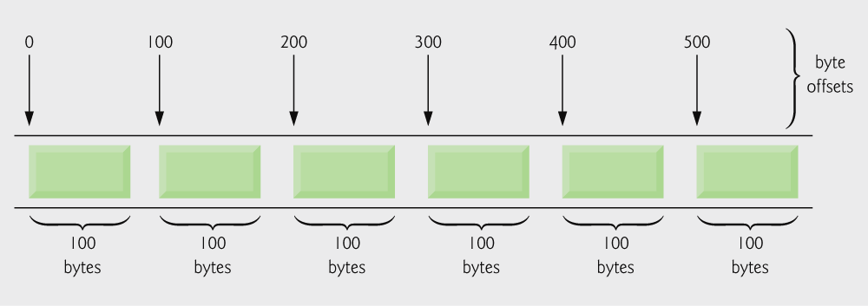
C’s view of a random-access file.

Slide 48
Creating a Random-Access File
Data in random access files
  Unformatted (stored as "raw bytes")
    All data of the same type (ints, for example) uses the same amount of memory
    All records of the same type have a fixed length
    Data not human readable

Slide 49
Creating a Random-Access File
Unformatted I/O functions
  fwrite
    Transfer bytes from a location in memory to a file
  fread
    Transfer bytes from a file to a location in memory
  Example:
    fwrite( &number, sizeof( int ), 1, myPtr );
    &number – Location to transfer bytes from
    sizeof( int ) – Number of bytes to transfer
    1 – For arrays, number of elements to transfer
      In this case, "one element" of an array is being transferred
    myPtr – File to transfer to or from

Slide 50
Creating a Random-Access File
Writing structs
  fwrite( &myObject, sizeof (struct myStruct), 1, myPtr );
  sizeof – returns size in bytes of object in parentheses
To write several array elements
  Pointer to array as first argument
  Number of elements to write as third argument

Slide 51
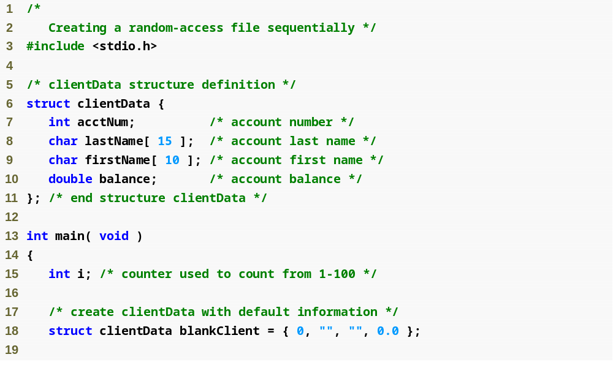

Slide 52
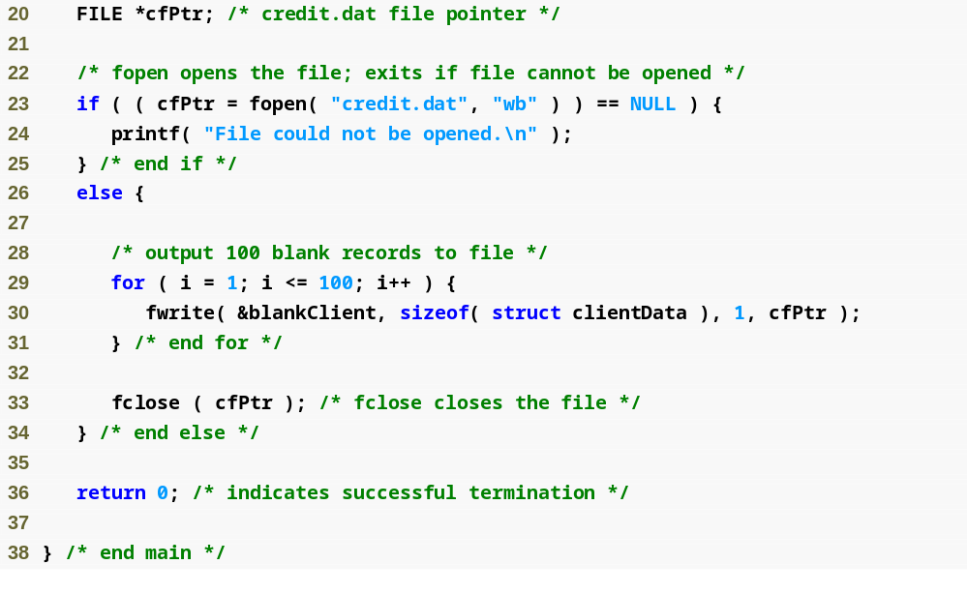
fopen function opens a file; wb argument means the file is opened for writing in binary mode
fwrite transfers bytes into a random-access file

Slide 53
Writing Data Randomly to a Random-Access File
fseek
  Sets file position pointer to a specific position
  fseek( pointer, offset, symbolic_constant );
    pointer – pointer to file
    offset – file position pointer (0 is first location)
    symbolic_constant – specifies where in file we are reading from
    SEEK_SET – seek starts at beginning of file
    SEEK_CUR – seek starts at current location in file
    SEEK_END – seek starts at end of file

Slide 54
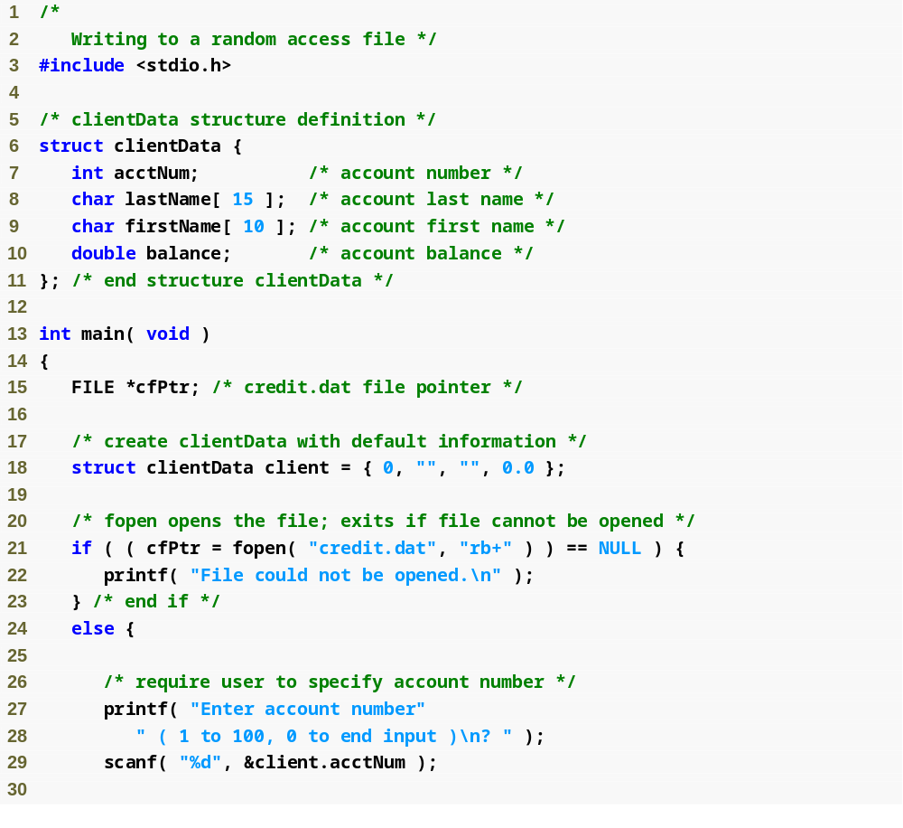

Slide 55
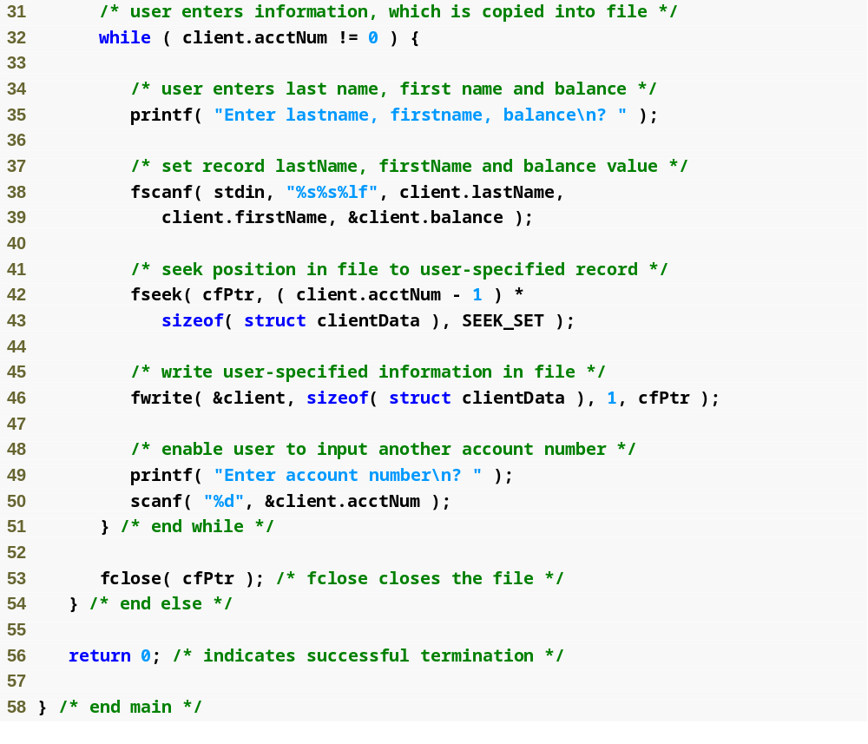
fseek searches for a specific location in the random-access file

Slide 56
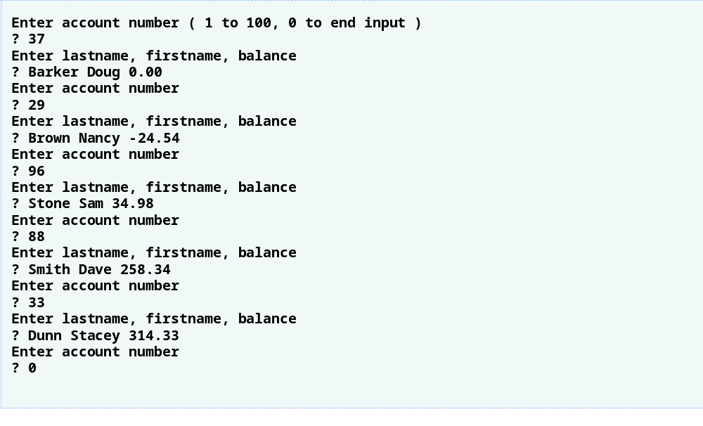
Output

Slide 57
Reading Data from a Random-Access File
fread
  Reads a specified number of bytes from a file into memory
    fread( &client, sizeof (struct clientData), 1, myPtr );
  Can read several fixed-size array elements
    Provide pointer to array
    Indicate number of elements to read
  To read multiple elements, specify in third argument

Slide 58
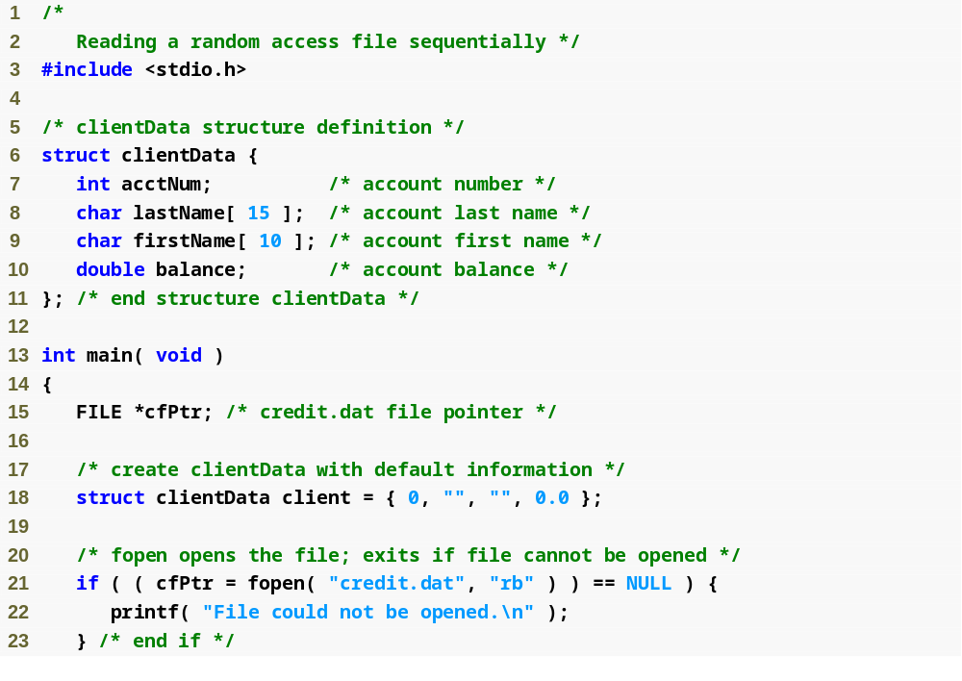

Slide 59
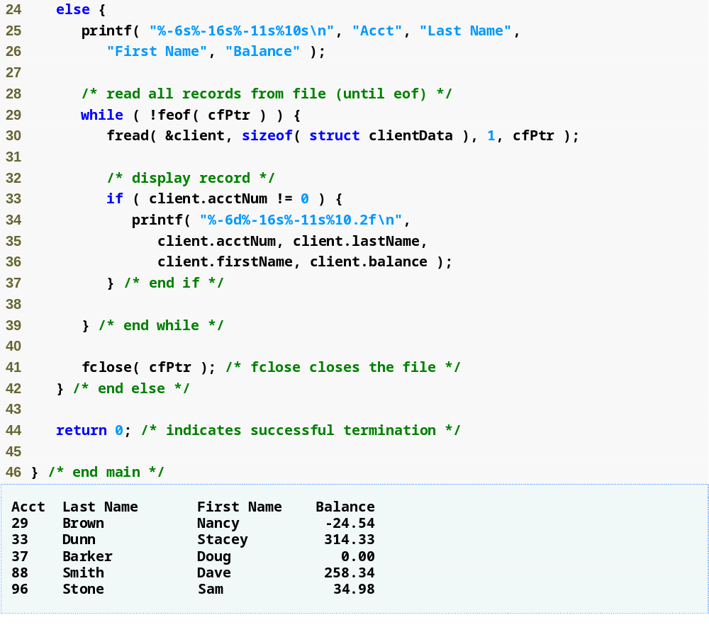
fread reads bytes from a random-access file to a location in memory

Slide 60
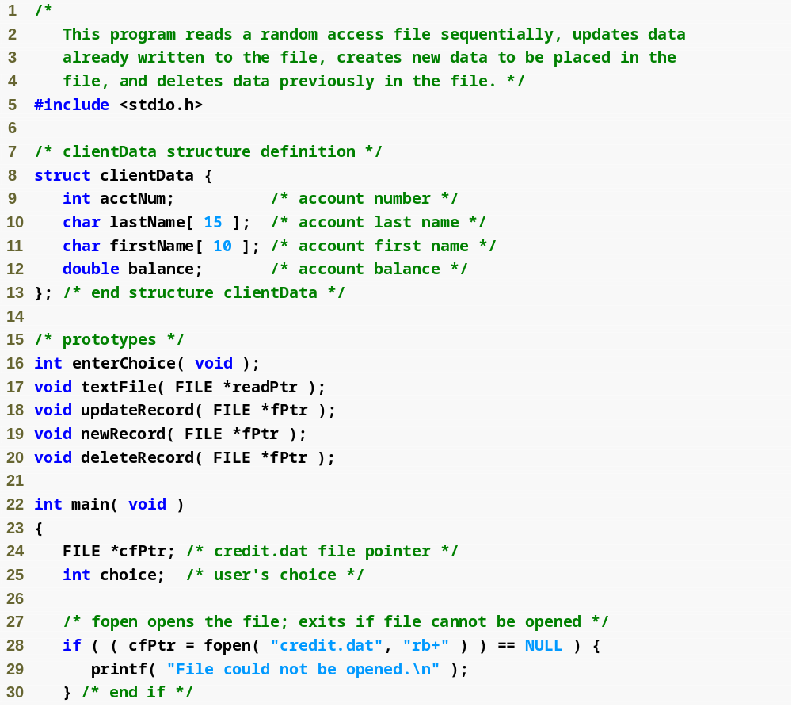

Slide 61
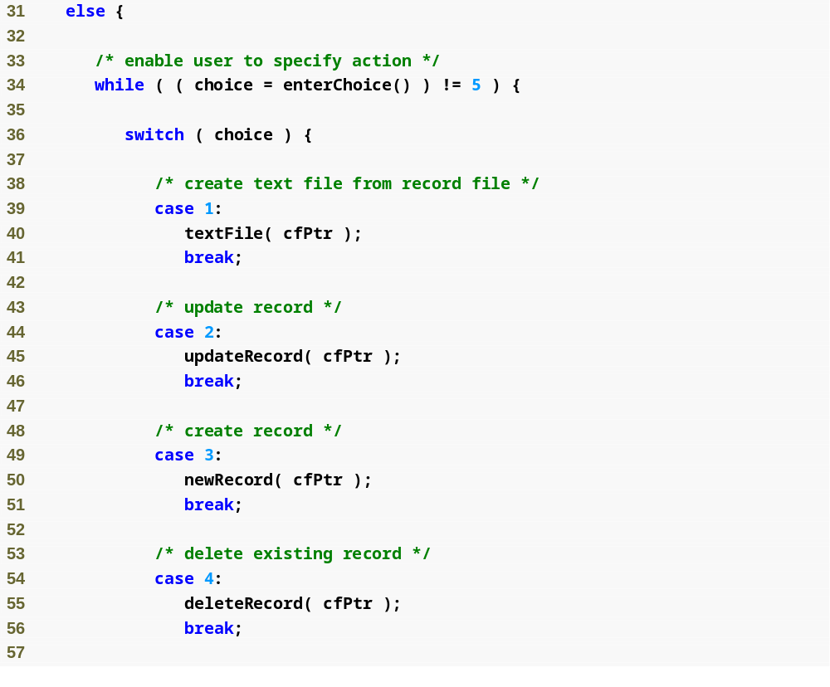

Slide 62
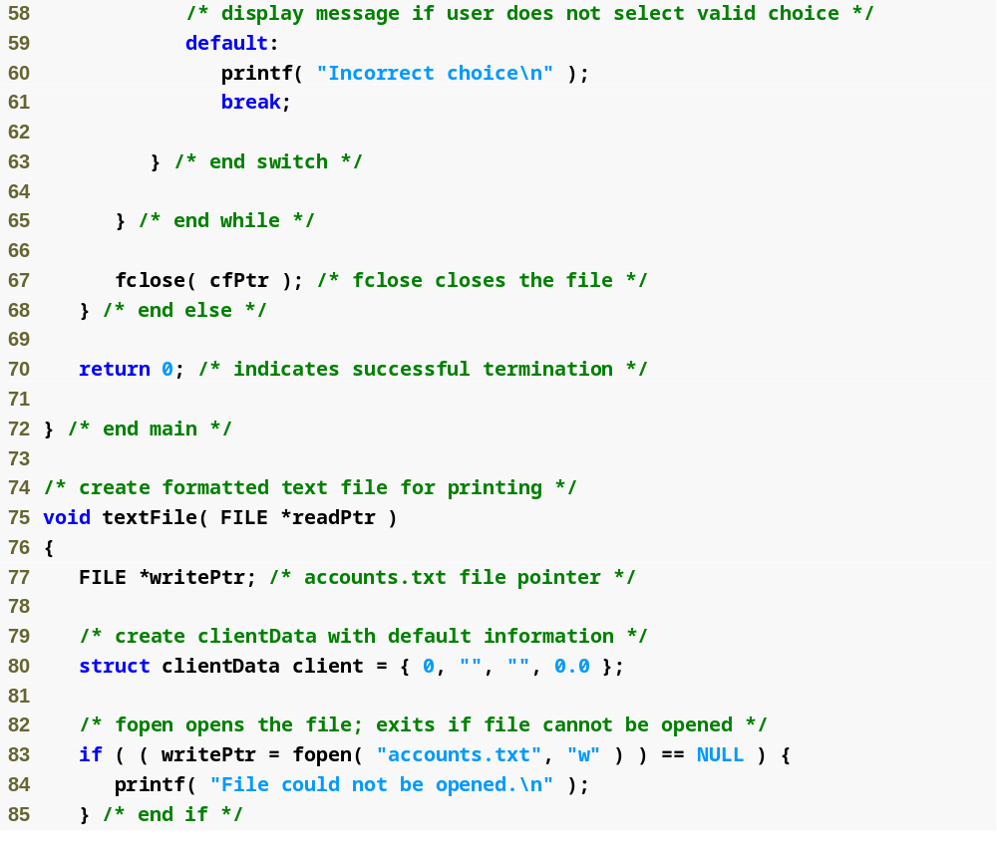
Function textFile creates a text file containing all account data

Slide 63
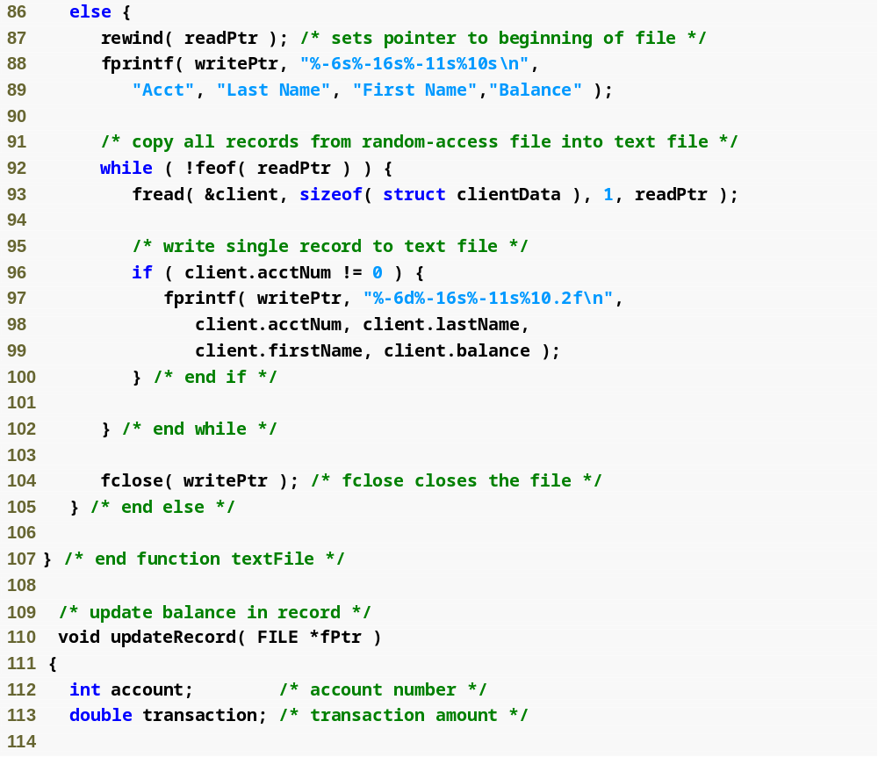
Function updateRecord changes the balance of a specified account

Slide 64
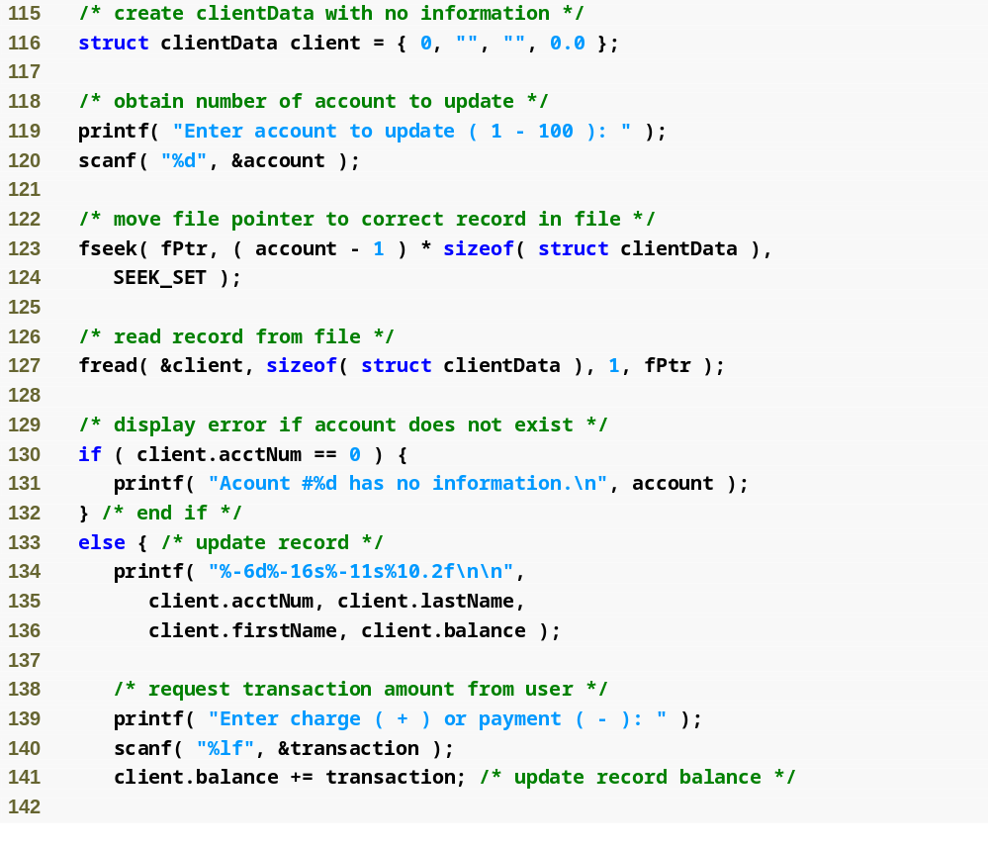

Slide 65
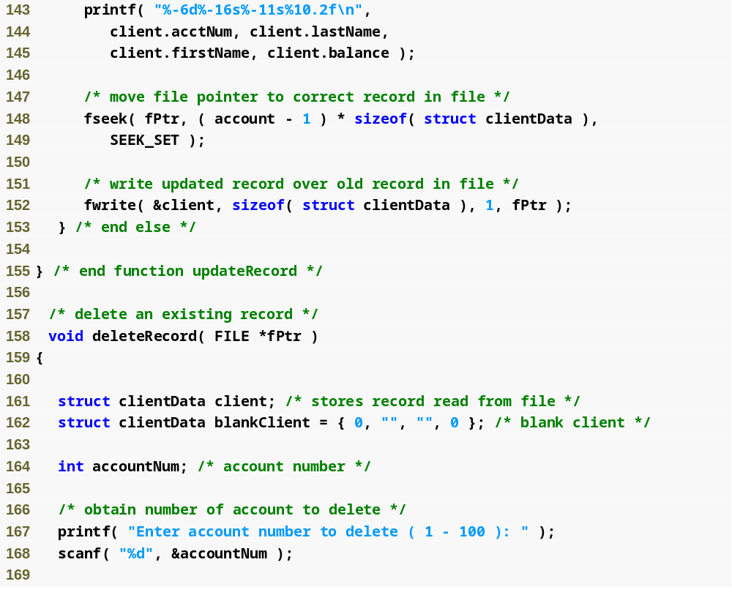
Function deleteRecord removes an existing account from the file

Slide 66
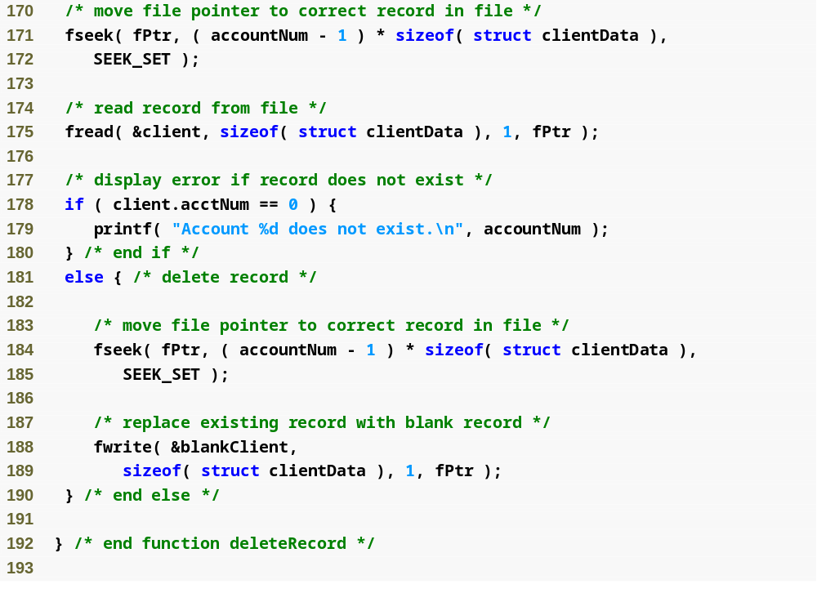

Slide 67
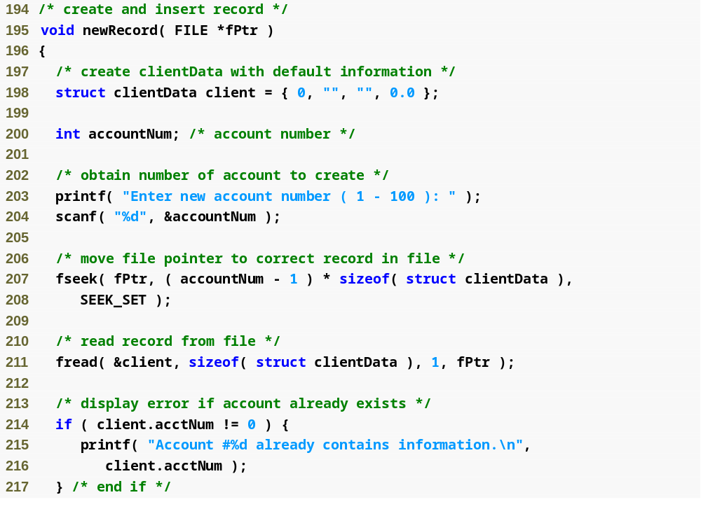
Function newRecord adds a new account to the file

Slide 68
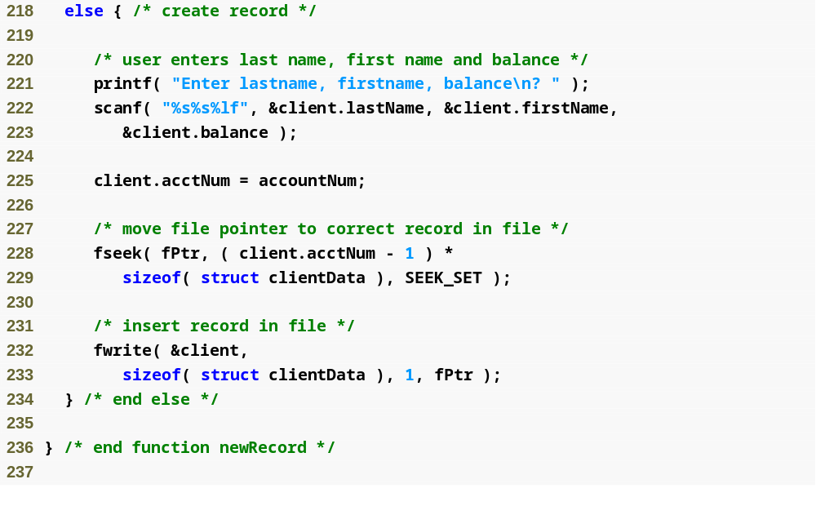

Slide 69
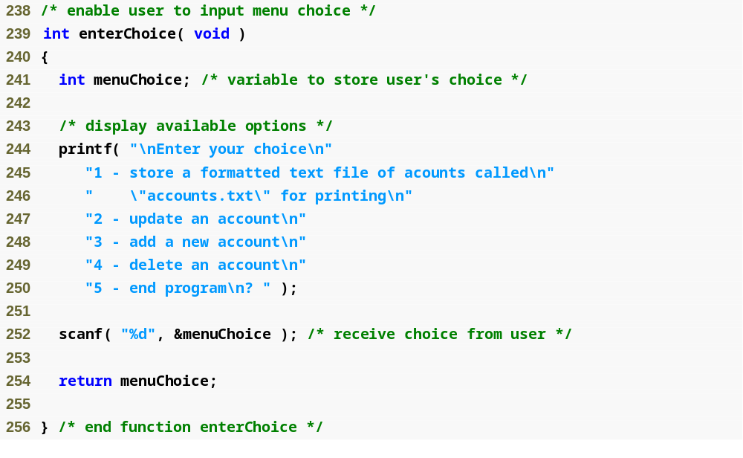

Slide 70
Referance
Ioannis A. Vetsikas, Lecture notes
Dale Roberts, Lecture notes

